Slide 1
Amazon challenge
Michael Du

Slide 2
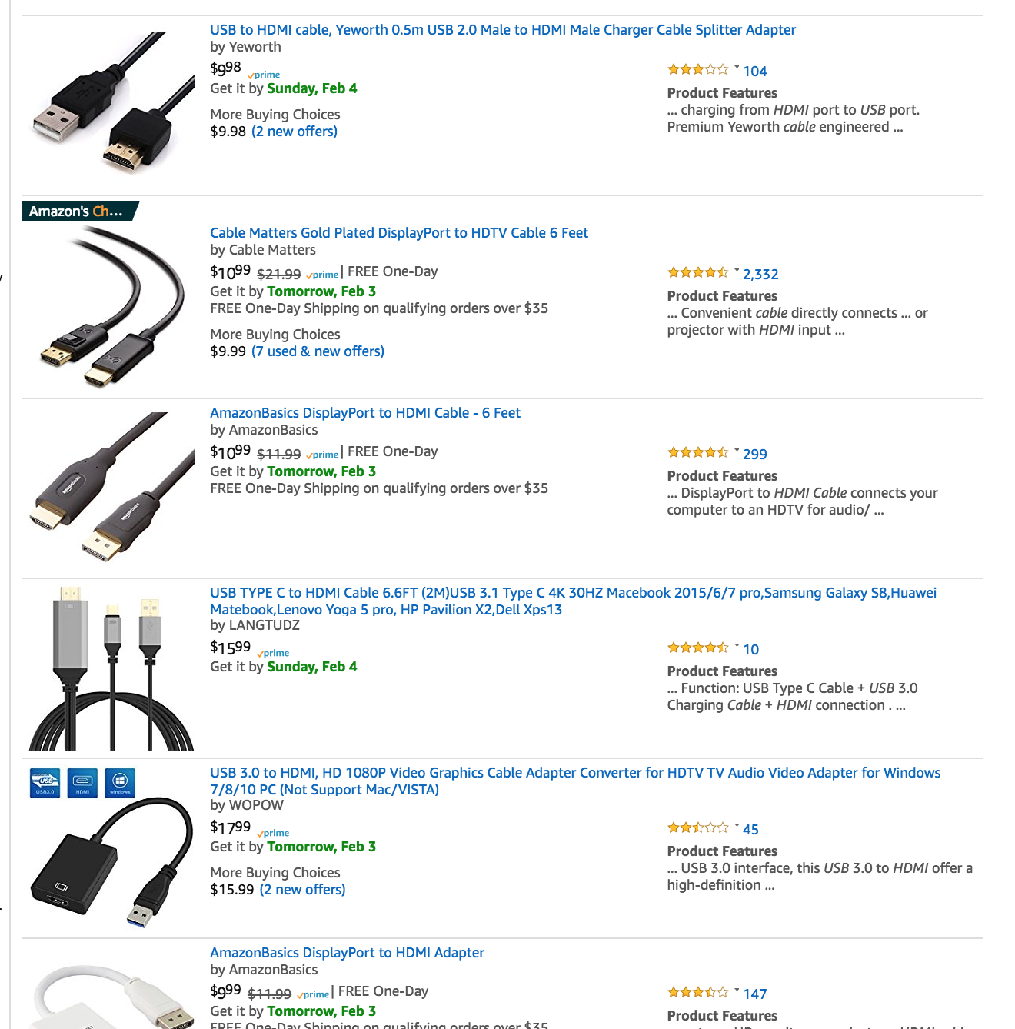
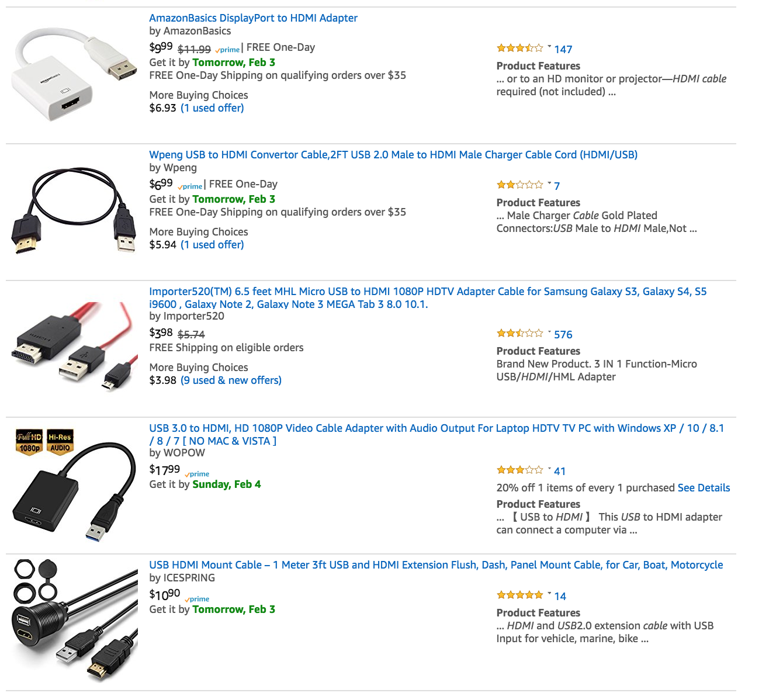

Slide 3
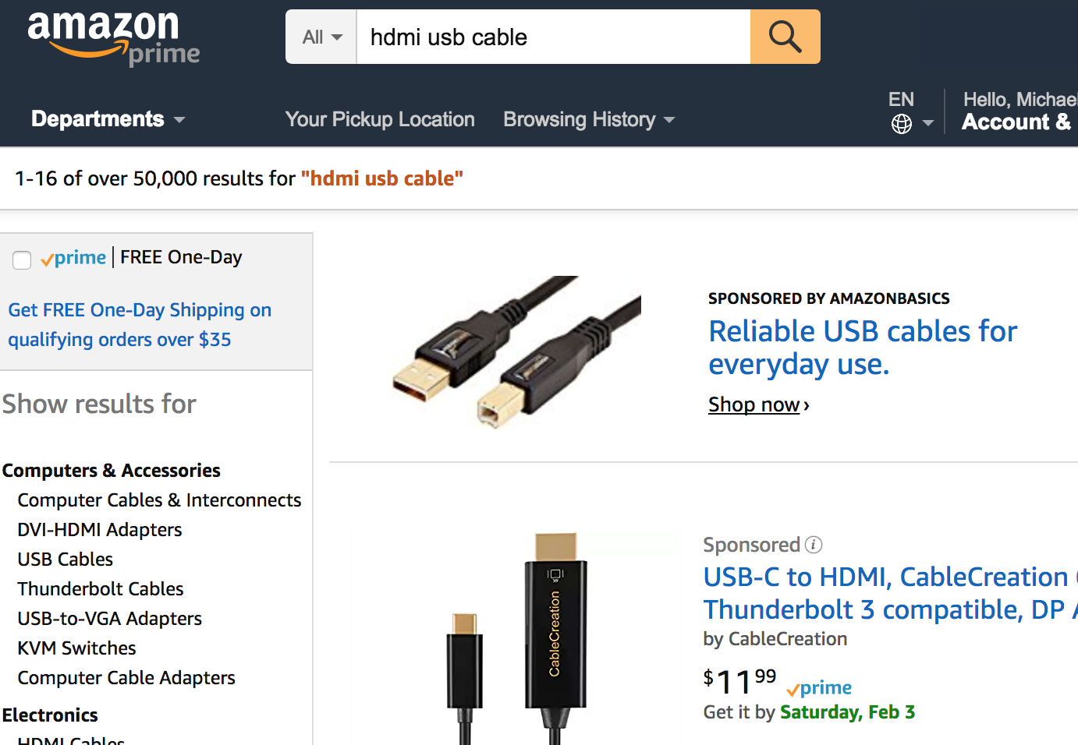
PAGE PLACEMENT MATTERS

Slide 4



Slide 5
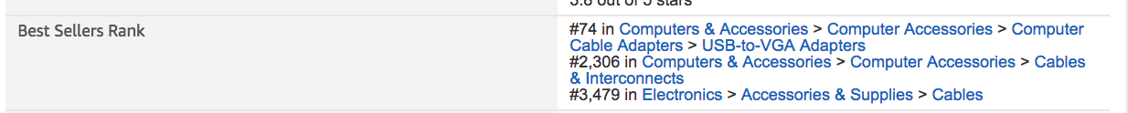
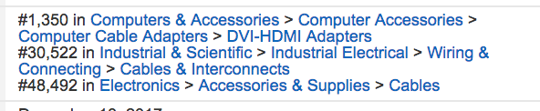

Slide 6
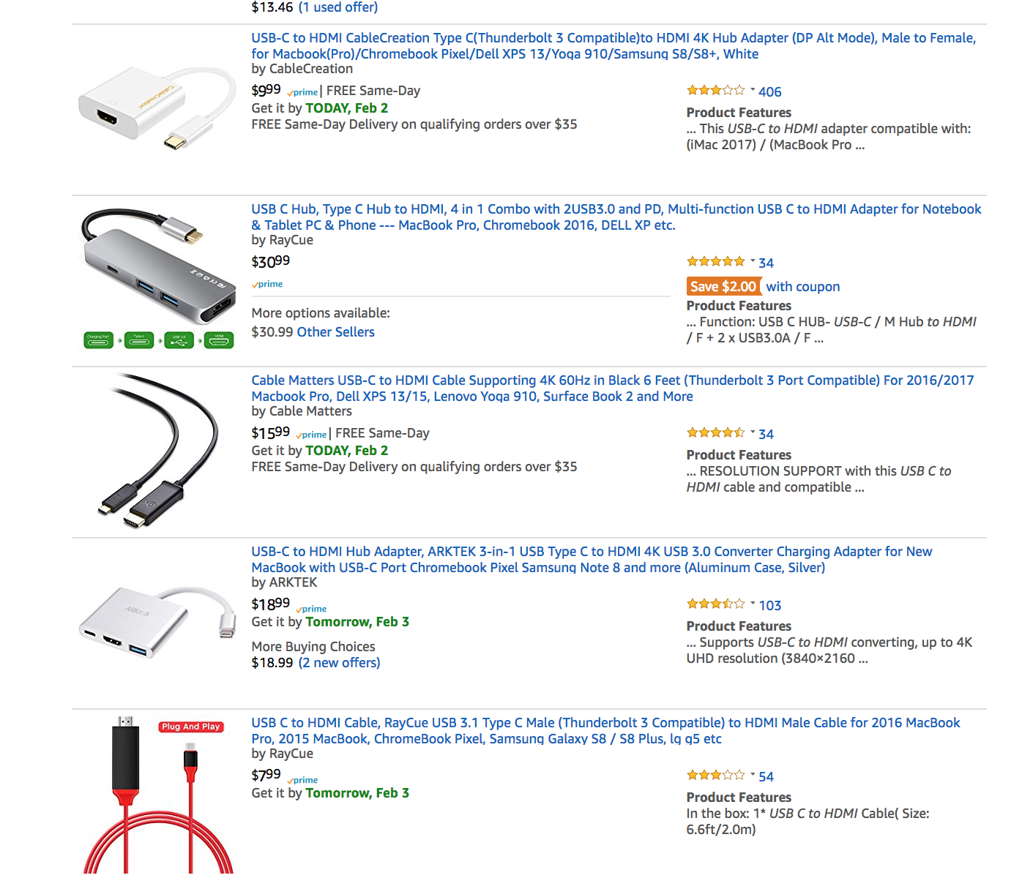
Page 1

Slide 7
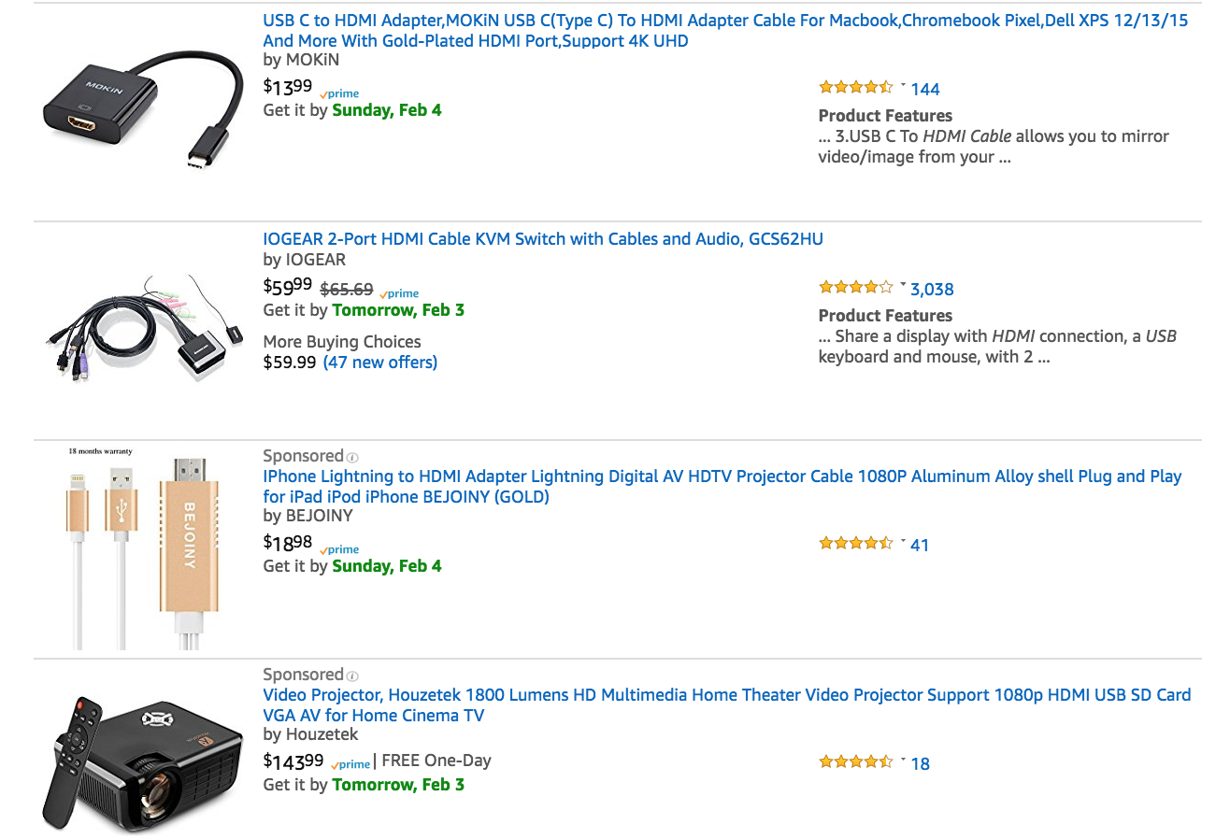
Page 8

Slide 8
FEATURES observed
Rating
Price
Review Count
1- 5 Star Counts (individually)
Number of variations
Days Since Launch
Weight (in ounces)
Volume
Amazon Rank (label)

Slide 9
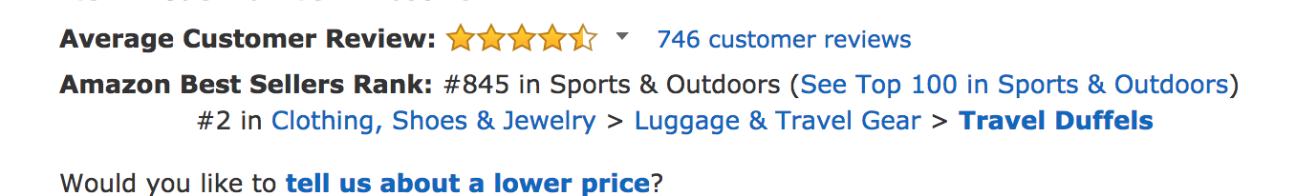
Process of elimination
13038 Rows
12590 with ranking
11029 in 'Clothing Shoes & Jewelry’ category

Slide 10
Missing data
Rating | 0
review_count | 0
1Star | 0
2Star | 0
3Star | 0
4Star | 0
5Star | 0
style_count | 0
days_since_launch | 2
weight_ounces | 1331
volume | 3983
min_price | 570
amazon_rank | 0

Slide 11
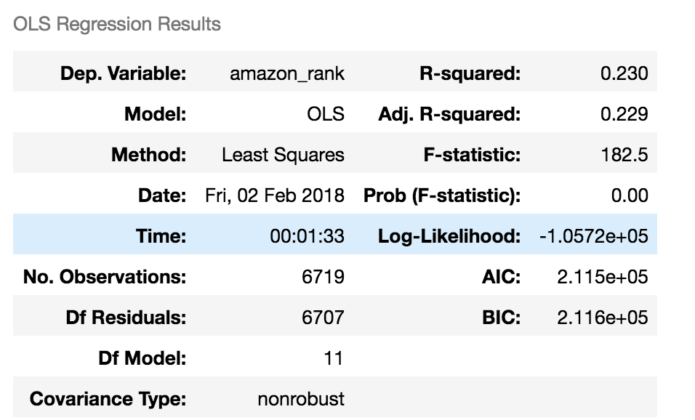
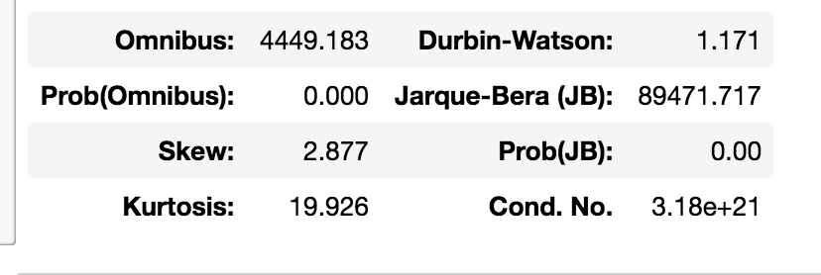
OLS With volume feature
6719 Rows

Slide 12
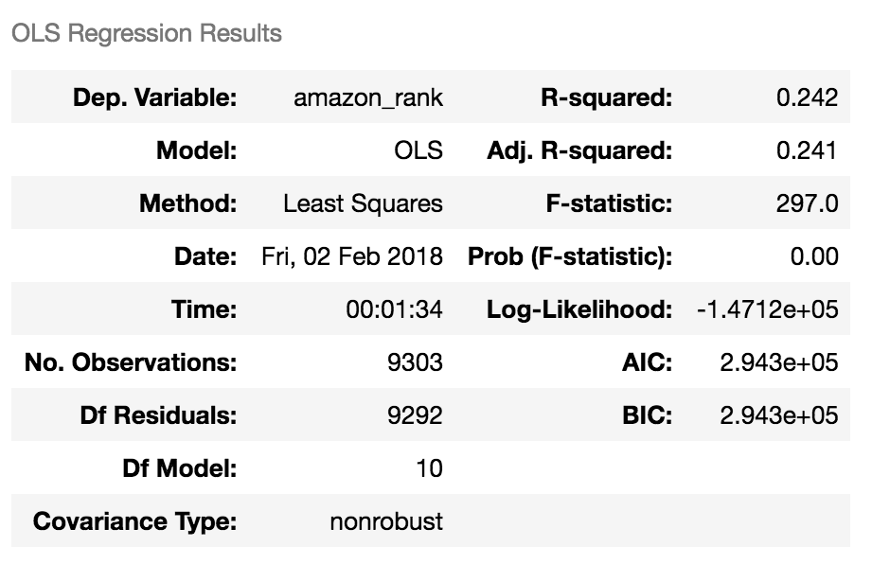
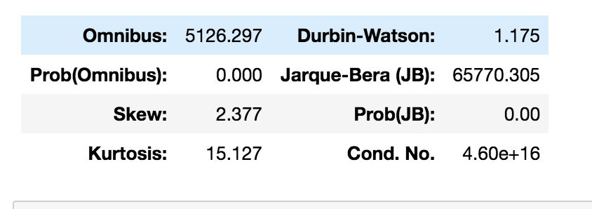
OLS Without Volume feature
9303 rows

Slide 13
Set-up
20% Testing
20% Validation
60% Training

Slide 14
Simple linear regression
OLS regression score val R²: 0.247
OLS regression score val RMSE: 1777604.940
Squared terms regression val R² : 0.304
Squared terms regression score val RMSE: 1709181.702
Chose Squared Terms

Slide 15
Simple linear regression on test data
Trained on 80% training data, tested on 20% test data
Squared terms regression val R² : 0.284
Squared terms regression score test RMSE: 1711967.724

Slide 16
Simple linear regression with polynomials
PolynomialFeatures(degree=2, interaction_only=True)
OLS regression with interaction terms val R² : 0.231
OLS regression with interaction terms val RMSE: 1797072.029
PolynomialFeatures(degree=2, interaction_only=False)
OLS regression with interaction terms val R² : 0.268
OLS regression with interaction terms val RMSE: 1752478.091

Slide 17
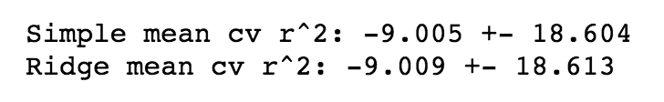
Incorporating kfold & ridge
5 fold, shuffled
Basic Linear Regression
Ridge with alpha = 1
LR scores: 0.29948, -46.212056, 0.29036, 0.2856156, 0.31393
Ridge scores: 0.2994170, -46.23560, 0.290255, 0.285927, 0.314192

Slide 18
Regularization with alpha testing
Alphas from 0.0003 to 10000 (500 step increments)
Standardized
Ideal Alpha Values:
Lasso: 10,000.0
Ridge: 3,557.15020682 R²: 0.226352859425
ElasticNet: 1.18071284 R²: 0.221034336523

Slide 19
LASSOcv
Rating | -2402178.9 |  | Rating**2 | 1486880.92
review_count | 0 |  | review_count**2 | 0
1Star | 29098.2997 |  | 1Star**2 | 21442.3024
2Star | 0 |  | 2Star**2 | 0
3Star | 0 |  | 3Star**2 | -22090.441
4Star | 0 |  | 4Star**2 | 0
5Star | -361469.32 |  | 5Star**2 | 228504.667
style_count | -314886.94 |  | style_count**2 | 190000.581
days_since_launch | 557210.006 |  | days_since_launch**2 | -343440.64
weight_ounces | -458083.38 |  | weight_ounces**2 | 377019.578
price | 41709.1034 |  | price**2 | 20840.8016
Tested alphas between 0.003 to 100,000
Best Alpha: 6080.2242
R² : 0.28292

Slide 20
Random forest
R² : 0.417585

Slide 21
Model Comparison
OLS | OLS Squared Terms | ElasticNet
0.247 | 0.304 | 0.221034336523
Ridge | LassoCV | Random Forest
0.226352859425 | 0.28292 | 0.417585

Slide 22
Rating | -1,342,232.27 |  | Rating**2 | 192,681.56
review_count | 2,717.26 |  | review_count**2 | -1.98
1Star | 5,537.49 |  | 1Star**2 | 20.51
2Star | 5,380.01 |  | 2Star**2 | 61.58
3Star | -2,053.70 |  | 3Star**2 | -62.15
4Star | 5,263.32 |  | 4Star**2 | 9.47
5Star | -11,409.86 |  | 5Star**2 | 7.82
style_count | -83,478.22 |  | style_count**2 | 1,966.42
days_since_launch | 800.94 |  | days_since_launch**2 | -0.13
weight_ounces | -3,043.57 |  | weight_ounces**2 | 0.37
min_price | 516.71 |  | min_price**2 | 0.03

Slide 23
Next steps
Set categorical variable for styles
Identify outliers
8800 out of 9300 listings have less than 15 reviews

